Slide 1

Cycle Sort
Java

Slide 2
Cycle Sort
Benefit
Uses the least number of writes to the original array
How
It uses cycles to move the elements of the array to their correct positions

Slide 3
Cycles
A cycle can be thought of as a graph

Slide 4
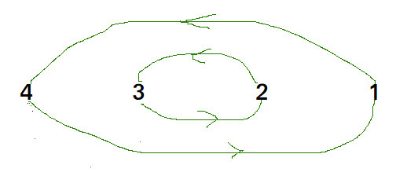
Cycles
Array i = [4,3,2,1]
After sort,
i[] = [1,2,3,4]

Slide 5
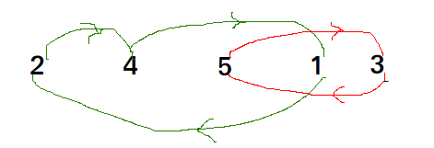
Cycles
i[] = [2,4,5,1,3]
After sort
i[] = [1,2,3,4,5]

Slide 6
Java Implamentation
// Function sort the array using Cycle sort
public static void cycleSort (int arr[], int n)
{
// count number of memory writes
int writes = 0;
// traverse array elements and put it to on
// the right place
for (int cycle_start=0; cycle_start<=n-2; cycle_start++)
{
// initialize item as starting point
int item = arr[cycle_start];
// Find position where we put the item. We basically
// count all smaller elements on right side of item.
int pos = cycle_start;
for (int i = cycle_start+1; i<n; i++)
if (arr[i] < item)
pos++;
// If item is already in correct position
if (pos == cycle_start)
continue;
// ignore all duplicate elements
while (item == arr[pos])
pos += 1;
// put the item to it\'s right position
if (pos != cycle_start)
{
int temp = item;
item = arr[pos];
arr[pos] = temp;
writes++;
}
// Rotate rest of the cycle
while (pos != cycle_start)
{
pos = cycle_start;
// Find position where we put the element
for (int i = cycle_start+1; i<n; i++)
if (arr[i] < item)
pos += 1;
// ignore all duplicate elements
while (item == arr[pos])
pos += 1;
// put the item to it\'s right position
if (item != arr[pos])
{
int temp = item;
item = arr[pos];
arr[pos] = temp;
writes++;
}
}
}
}

Slide 7
Implamentation
int arr[] = {1, 8, 3, 9, 10, 10, 2, 4 };
int arr[] = {1, 8, 3, 9, 10, 10, 2, 4 };
int arr[] = {1, 8, 3, 9, 10, 10, 2, 4 }; // Before Sort
int n = arr.length;
cycleSort(arr, n) ;
System.out.println("After sort : ");
for (int i =0; i<n; i++) {
System.out.print(arr[i] + " ");
}

Slide 8
After Sort
After sort :
1 2 3 4 8 9 10 10

